Slide 1
Advanced - Topic 1 – Logging On and What are Networks
Starter
Using the login details your teacher gives you, log in. Help others.
Make the following folders if you do not already have them:
Year 7, Year 8, Year 9
Inside Year 7 create a ‘Computing’ sub folder
Inside the ‘Computing’ folder make sub folders as follows:
Introduction
Small Basic
Spreadsheets
Theory

Slide 2
Logging On To The network
Username – 21SmithJ@croftonschool.co.uk
Password – You need to choose a password that you will remember (put it here ‘ ‘)
Password
Number
Uppercase letter
Lowercase letter
Symbol
Minimum 6 digits
How to save to your network area
Read the Computing agreement in your planner and sign

Slide 3
Advanced - Topic 1 – Logging On and What are Networks
Foundation:
Up to and including 3
Your teacher will tell you’re your target grade:
3. Go to the Pupil Work area
> Year 7
> Computing
>Introduction
>Foundation, Intermediate or Advanced
Copy all of the documents in this area and paste them in your Introduction folder.
If you do not have a target grade choose the Intermediate documents.
Complete the following 4 slides:
Intermediate:
4 to 5
Advanced:
6 and above

Slide 4
Mastery Statements Level 6+
Mastery 6
6(1) I can combine multiple digital devices, internet services and application software to create information about the School Network.
6(3) I can evaluate the trustworthiness of digital content and consider the usability of visual design features when designing and creating digital artefacts for known audience.
6(4) I can design criteria for users to evaluate the quality of solutions, and can use the feedback from users to identify improvements and can make appropriate refinements to the solution.
6(4) I can identify and explain how the use of technology can impact on society.
Mastery 7 (Extension)
7(1) I can undertake creative projects that collect, analyse, and evaluate data to meet the needs of a known user group.
7(2) I can effectively design and create digital artefacts for a wider or remote audience
7(3) I consider the properties of media when importing them into digital artefacts.
7(4) I can document user feedback, the improvements identified and the refinements made to the solution.
7(5) I can explain and justify how the use of technology impacts on society, from the perspective of social, economical, political legal, ethical and moral issues.

Slide 5

Produce a leaflet on the Network at Crofton School
Use the information in slides 6-8 to start a leaflet on the Network at Crofton School
Notes:
Make your leaflet for 11 – 12 year olds.
Write full sentences on the information.
You could add images.
You could import a table.
You could create a questionnaire to gain feedback.
Identify and explain how the use of this technology has an impact on society.
Think of other applications you could use in this task.
You could work with someone else in the room using Office 365?
Gain 1 x www (what went well)
Gain 2 x ebi (even better if)
Act on the feedback.
Look at slide 4’s mastery statements for further guidance.
Star Network
A star network is ..
Network
A network is
Printing
To print at our school

Slide 6
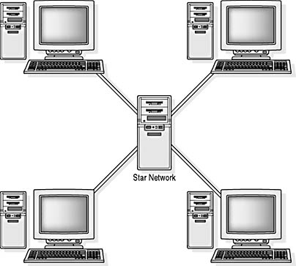
What Is A Network?
We use a star network

Slide 7
What is A Network?
All of the computers are connected to a central SERVER
Each computer is called a CLIENT
You save to the server, not the Client
This means you can get your work from any computer in the school
Printers are also connected to the server

Slide 8
Printing
Virtual queue
Own password for copying
Allowance £1.50
3p B&W and 15p colour

Slide 9
How did I do?
 | Self Ass Y/N
A
B
C
D
E
F
G
Mastery 6
6(1) I combined multiple digital devices, internet services and application software to create a leaflet about the School Network.
6(1) I used text and images in my leaflet.
6(1) I imported a table into my leaflet.
6(3) I stated how using technology has an impact on society.
6(4) I gained feedback (1 x www)
6(4) I gained feedback (2 x ebi)
6(4) I made improvements to my work.

